Slide 1


TMDB 5000 Movies Classification
By: Basil Latif

Slide 2
Project Goals:
Goal: My TMDB 5000 movies classification project will examine how budget and user preference for a movie affect whether or not it’s profitable. This will help determine if movies that become profitable due to the fact that it had a high budget or because viewers of the film liked it them. The tool to conduct the analysis will be a decision tree.
Dependent variable: Profit
Independent variable: Budget and User Vote Average

Slide 3
New Independent Variables Calculated:
Profit = revenue – budget
1= profitable 0=lost money
Budget_group=a series of buckets that place a film’s budget
Vote_group=a grouping of user voting averages for a film

Slide 4
4 Visualizations:

Slide 5
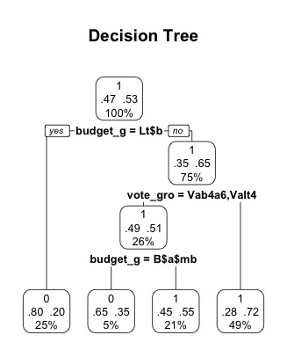
Pruned Decision Tree
1 = movie made a profit
0 = movie lost money

Slide 6
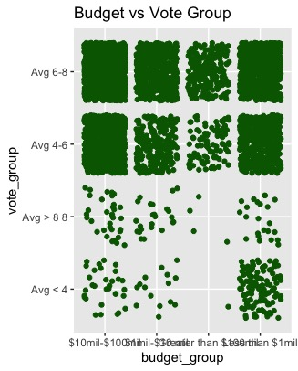
Budget Plotted Against Vote Group

Slide 7
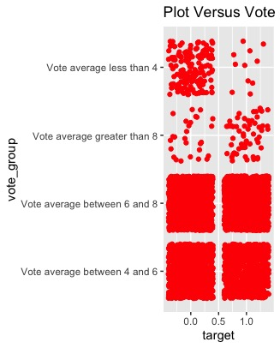
Target Variable Distribution by Vote Group

Slide 8
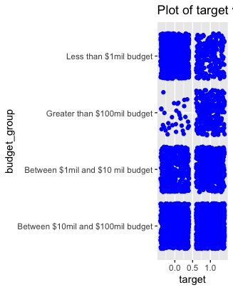
Target Variable Plotted By Budget Group

Slide 9
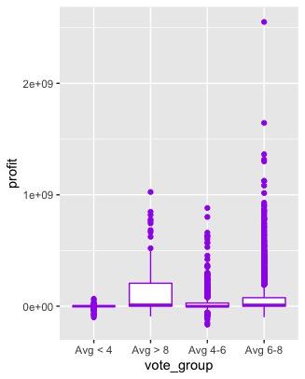
Box plot of Vote Group vs Profit

Slide 10
3 Insights
#1 The decision tree tells us that 53% of movies lost money
#2 The variable importance given by the npart function shows that budget is 4x more important than popularity
#3 The decision tree splits show us that for movies that lost money, most of them were unpopular

